Slide 1

Employee Data Analysis using Excel
STUDENT NAME: JERCY RANI A
REGISTER NO: 312215836
DEPARTMENT: B.COM ACCOUNTING AND FINANCE
COLLEGE: SHRI SHANKARLAL SUNDARBAI SHASUN JAIN COLLEGE FOR WOMEN
1
Notes:
1

Slide 2

PROJECT TITLE
Employee Performance Analysis using Excel
2

Slide 3



AGENDA
Problem Statement
Project Overview
End Users
Our Solution and Proposition
Dataset Description
Modelling Approach
Results and Discussion
Conclusion
3/21/2024 Annual Review
3

Slide 4

PROBLEM STATEMENT
Main Issue: Clearly state the problem related to employee performance that the analysis aims to address.
Business Impact: Explain the potential negative consequences of unaddressed performance issues on the organization.
Goal: Summarize the primary goal of the analysis.
4

Slide 5

PROJECT OVERVIEW
Objective: Outline the main objectives of the project.
Scope: Describe the scope of the analysis, including the departments involved and the time period analyzed.
Stakeholders: Identify the key stakeholders and their roles in the project.
5

Slide 6

WHO ARE THE END USERS?
Employees
Executives/Senior Leadership
HR Department
Managers/Supervisors
Training and Development Teams
6

Slide 7

OUR SOLUTION AND ITS VALUE PROPOSITION
Proposed Approach: Describe the proposed solution for addressing the performance issues.
Value Proposition: Explain the benefits this solution provides to the organization, such as improved decision-making or enhanced employee engagement.
Implementation: Provide a brief overview of the implementation strategy, including timelines and milestones.
7

Slide 8
Dataset Description
Employee data set taken from the KAGGLE.
In dataset, out of 26 data I took only 9 features out of it.
The selected 10 features are listed below:
Employee ID
First name
Last name
Business unit
Employee Type
Employee Status
Employee classification type
Gender Code
Performance Score
Current employee rating

Slide 9

THE "WOW" IN OUR SOLUTION
Personalized Insights:
Custom feedback tailored to individual strengths and career goals.
Development plans with clear, actionable steps for growth.
Real-Time Analytics:
Instant performance tracking and feedback.
Predictive insights to anticipate future trends and needs.
Engaging Experience:
Gamified elements to motivate and reward high performance.
Intuitive, mobile-friendly interface for on-the-go access.
Holistic Approach:
360-degree feedback for a comprehensive evaluation.
Integration of employee wellness into performance metrics
3/21/2024 Annual Review
9

Slide 10
MODELLING
1) DATA COLLECTION
The data has been collected through Edunet dash board.
2) FEATURE COLLECTION
The listed 10 features were taken for the analyses of data.
3) DATA CLEANING
Identifying the missing values.
Filtering of those missing values.
4)CALCULATION OF PERFORMANCE LEVEL
By considering the current employee rating, I found the performance level using the formula.
5)SUMMARY OF PIVOT LEVEL
Segregating od certain features to rows, columns, heading and so on.
6)VISUALIZATION:
Once completed with pivot table, created the graph for precise visualization.
10

Slide 11
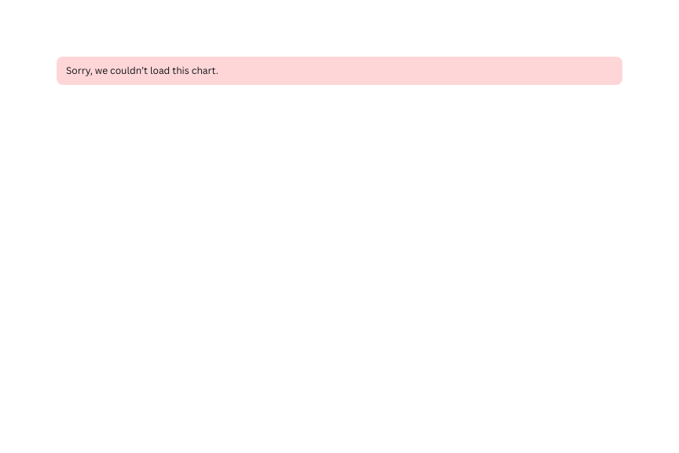

RESULTS
FORMULAS:
=IF(AND(Z8>=5),"VERY HIGH",IF(AND(Z8>=4),"HIGH",IF(AND(Z8>=3),"MED","LOW")))
11

Slide 12
conclusion
Summary: Recap the key insights and findings from the analysis.
Recommendations: Provide actionable recommendations based on the analysis, such as implementing training programs or revising performance incentives.
Future Work: Suggest potential areas for further research or analysis to continue improving employee performance management.

